Slide 1
Web Development Project
Movie Lookup Portal
Sreya Basu • 19/08/2022

Slide 2
Overview
Functionality
APIs
Technology Used

Slide 3
Functionality
Search a movie
Return a list of movies
Give an overview for a movie

Slide 4
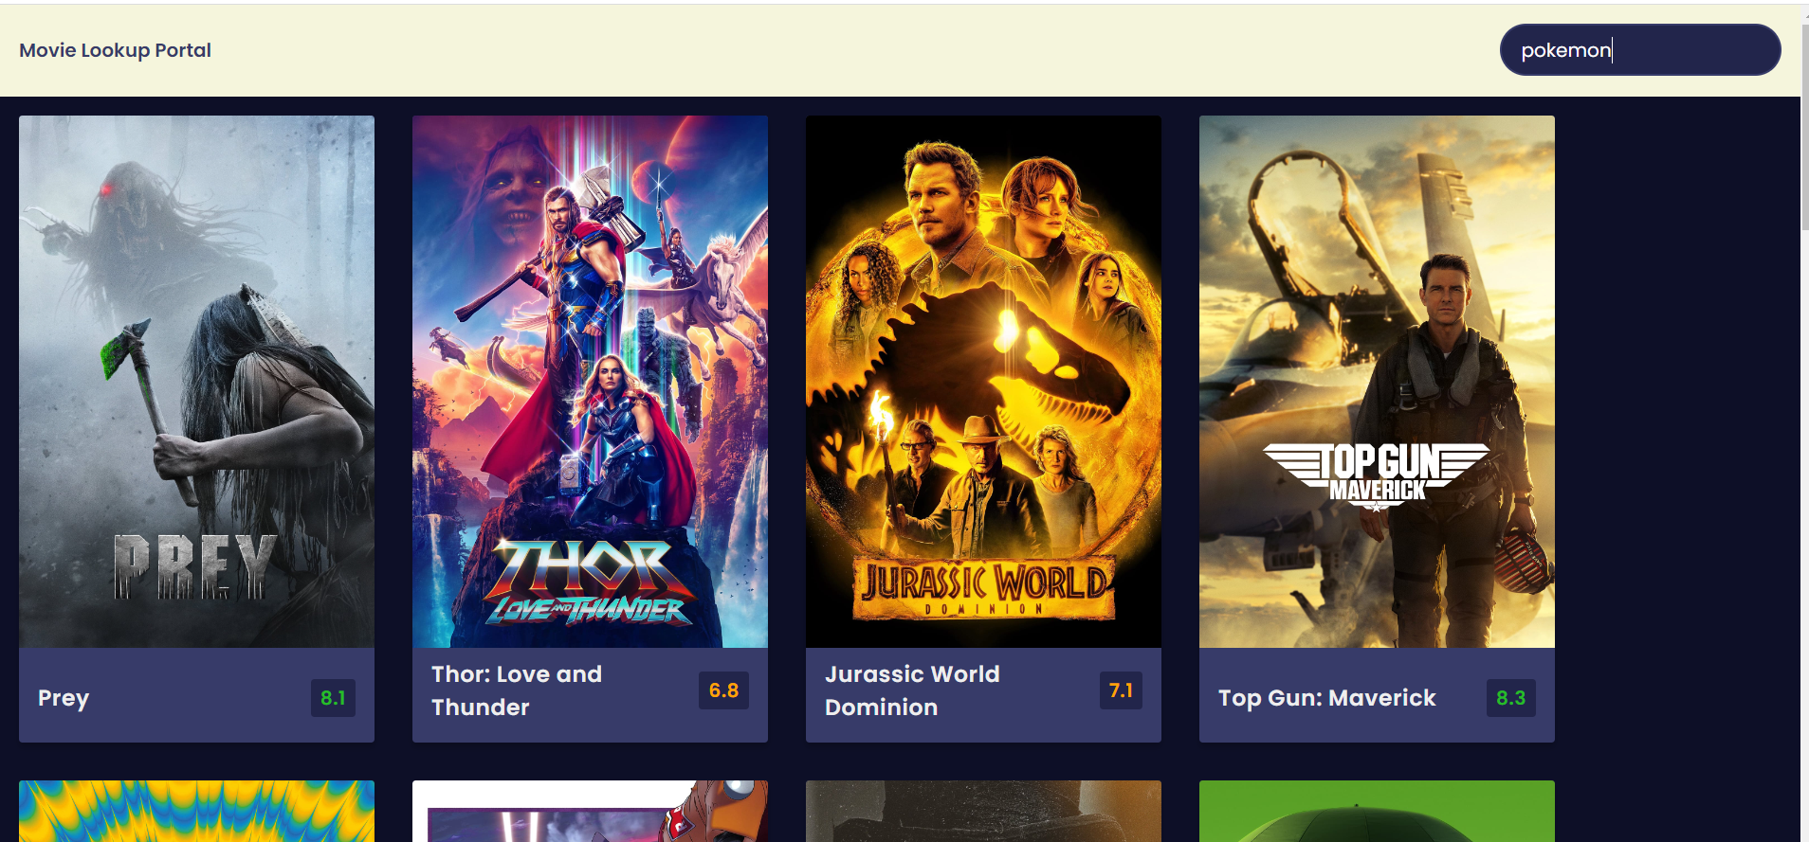

Slide 5
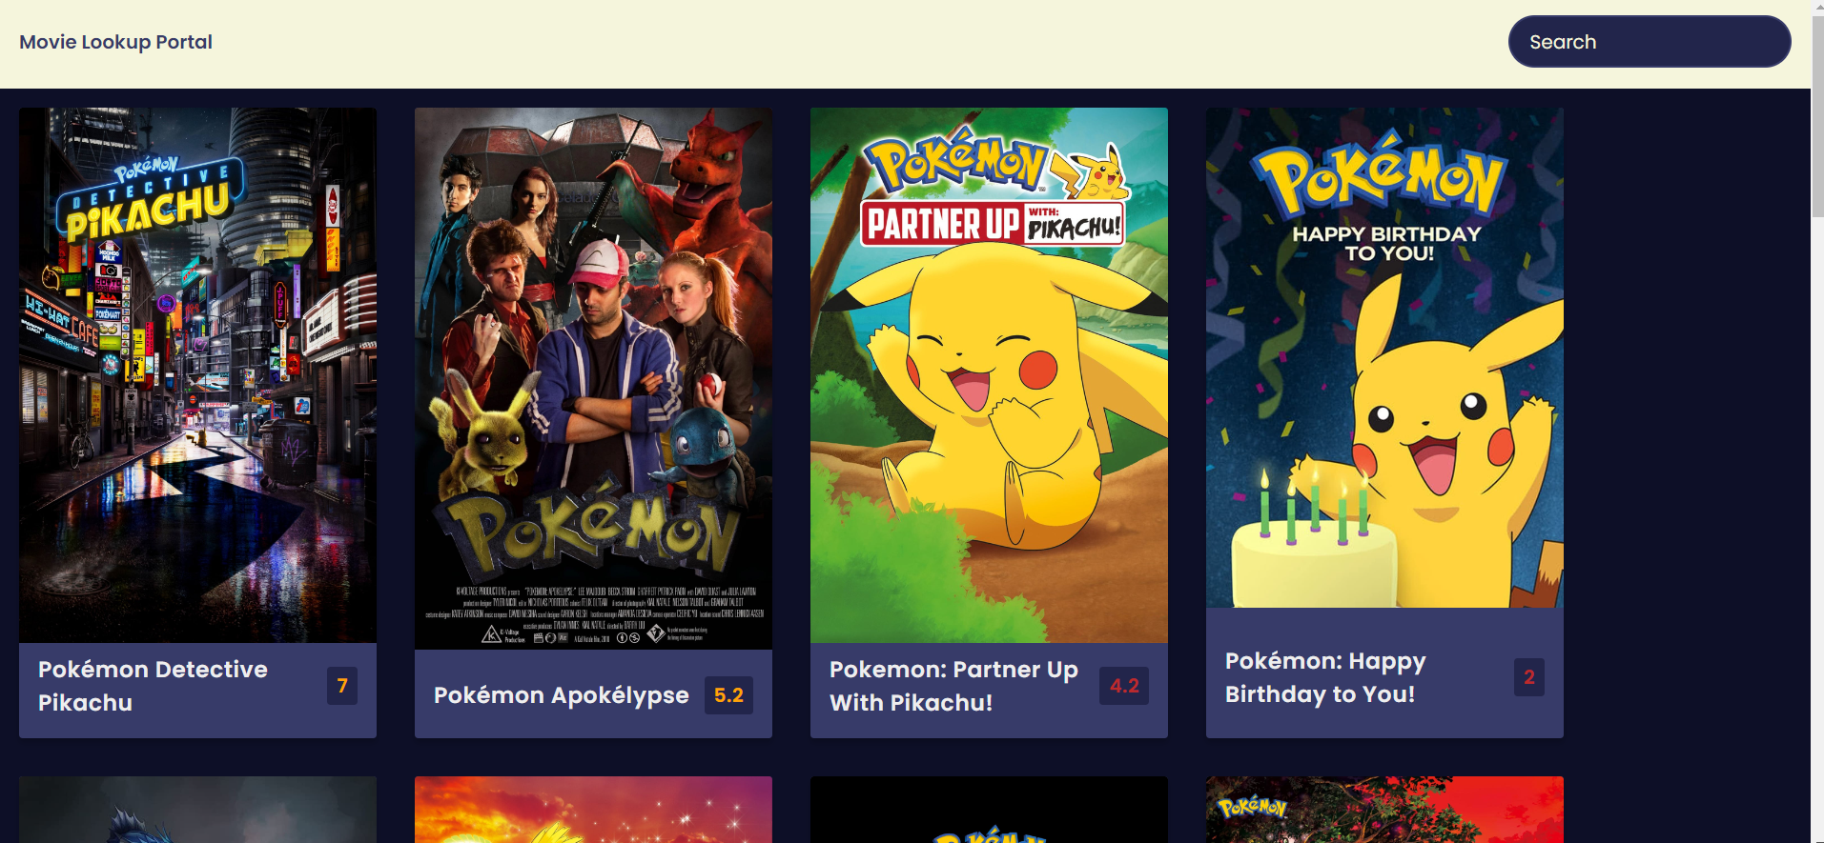

Slide 6
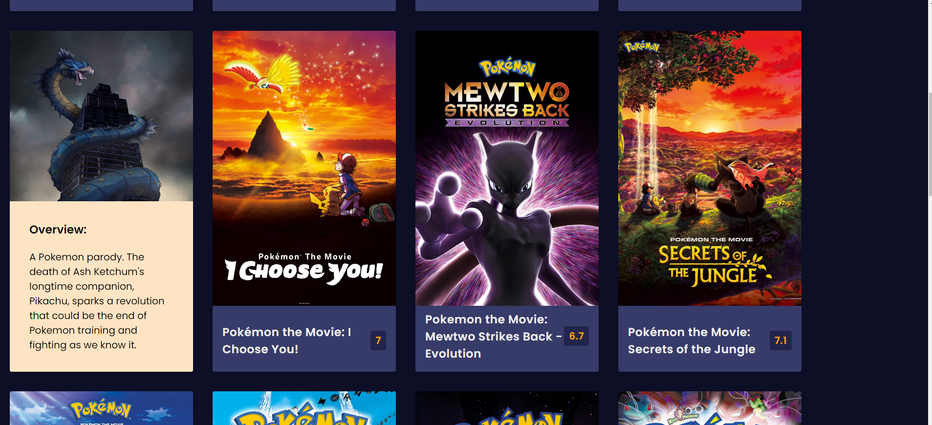

Slide 7
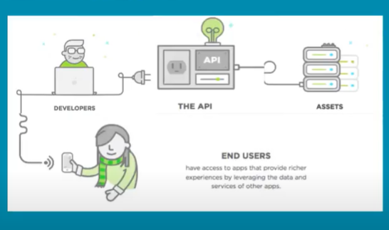
APIs

Slide 8
Technology Used
HTML
CSS
JS

Slide 9
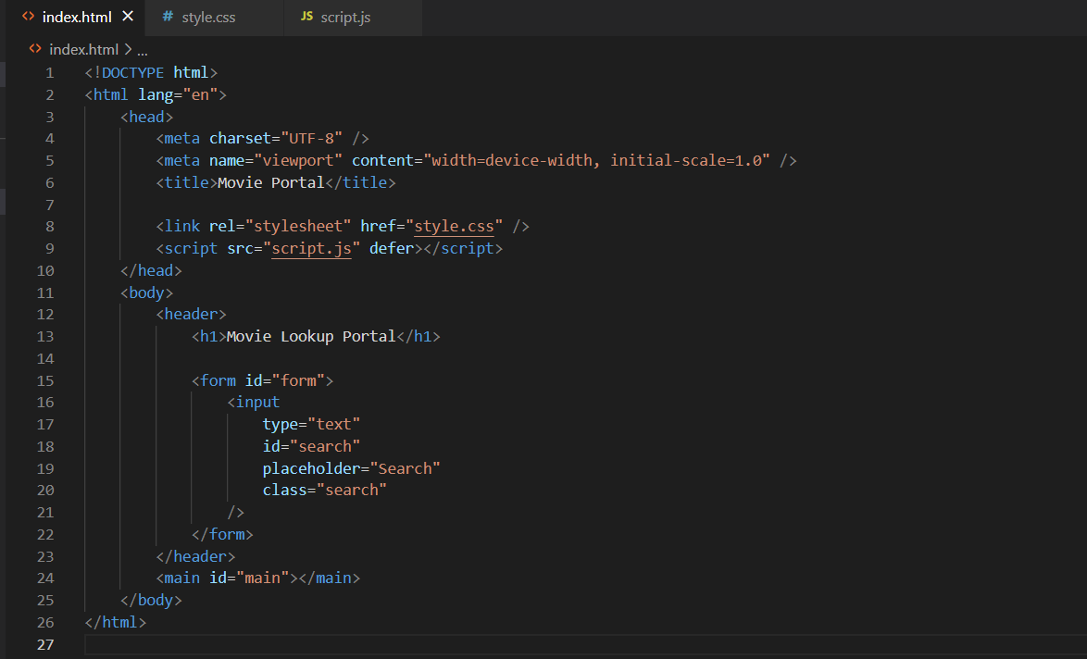
HTML

Slide 10
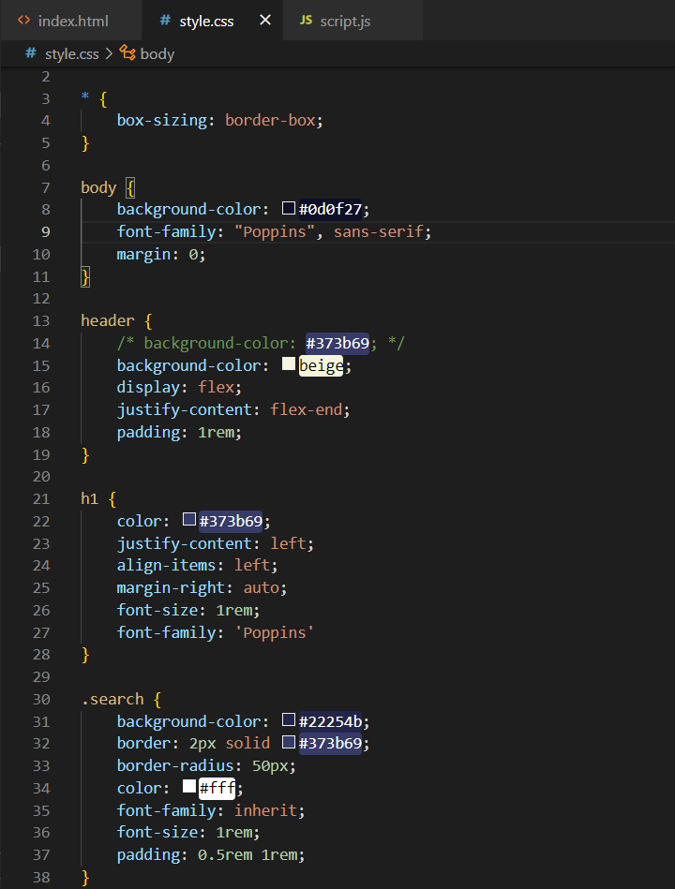
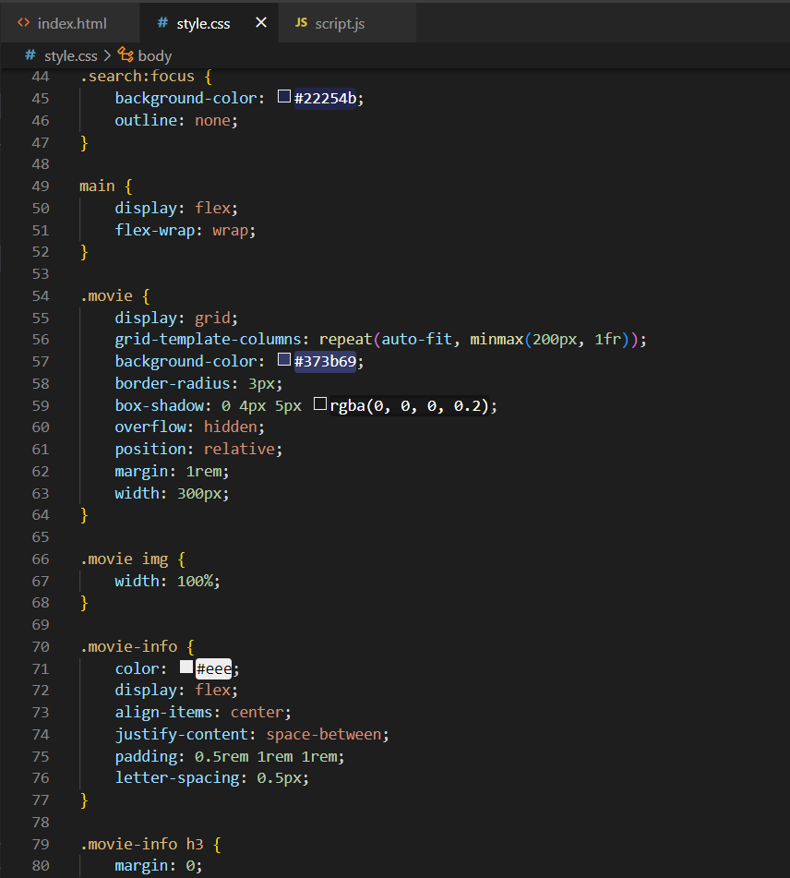
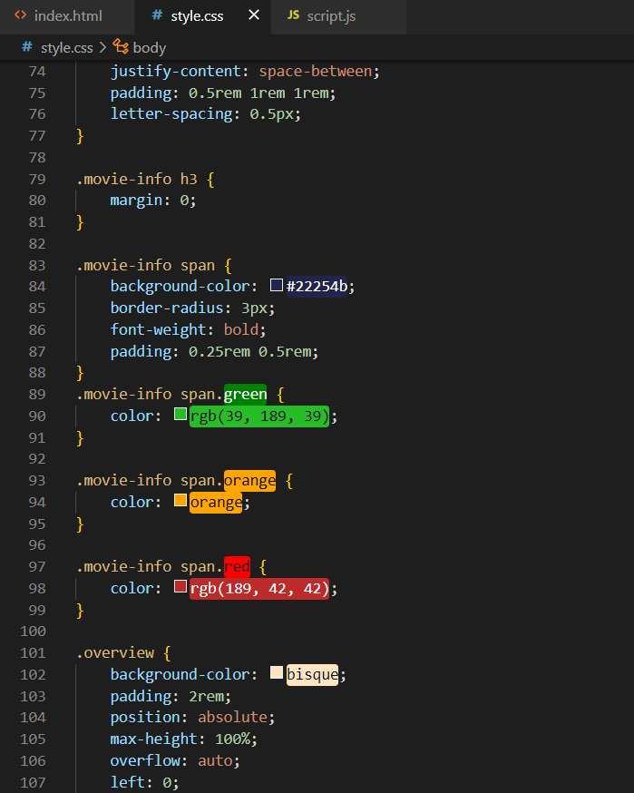
CSS

Slide 11
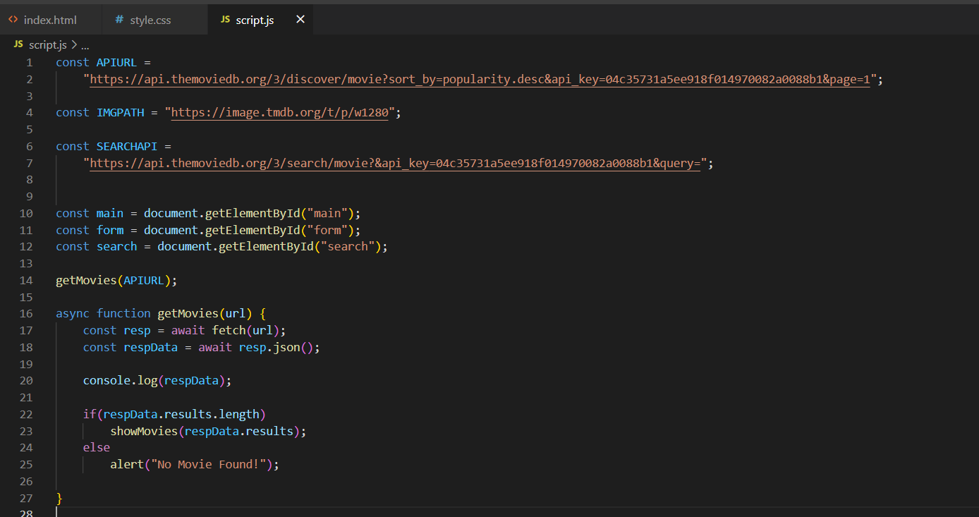
JavaScript

Slide 12
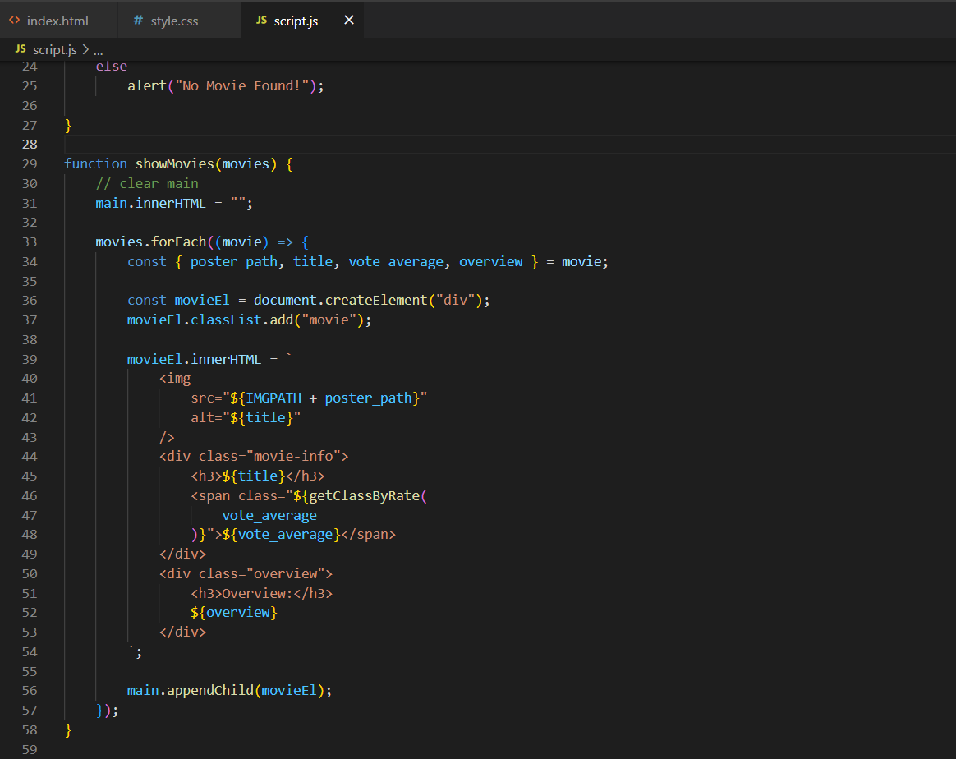
JavaScript

Slide 13
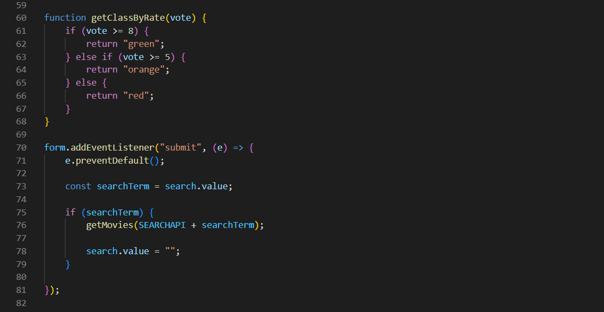
JavaScript

Slide 14
THANK YOU

